Slide 1
UNIVERSITY OF MYSORE
PRESENTATION OF UOM MODULES

Slide 2
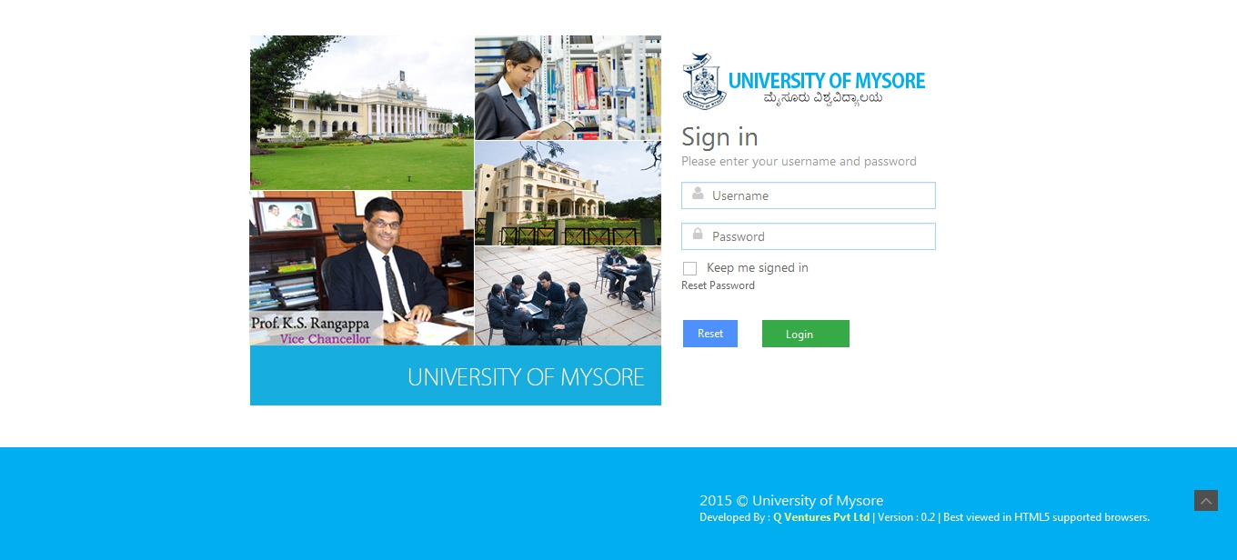
UOM LOGIN PAGE
The User can Login into UOM Application through this Screen

Slide 3
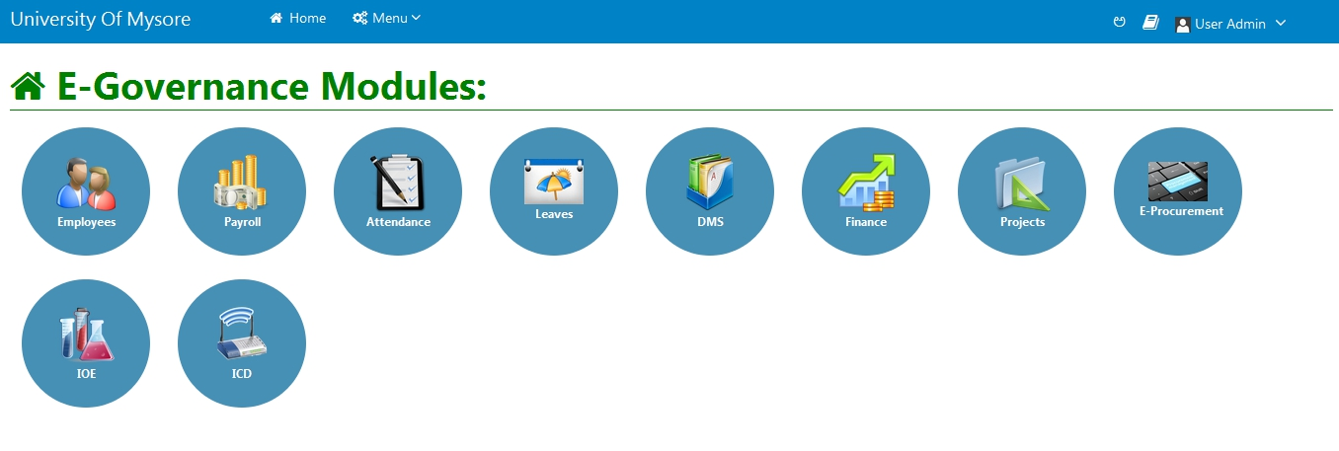
UOM DASHBOARD
As soon as the user logs in, the following screen appears with UOM Modules and Features

Slide 4
UNIVERSITY OF MYSORE
Document Management System (DMS) MODULE

Slide 5
DMS DASHBOARD
This screen displays the UOM Dashboard with DMS Features

Slide 6
CREATE FILE
The user can create a file by specifying the file name, file number, file type and attachments through this screen

Slide 7
CREATE FOLDER
The user can create a folder by specifying the folder name through this screen

Slide 8
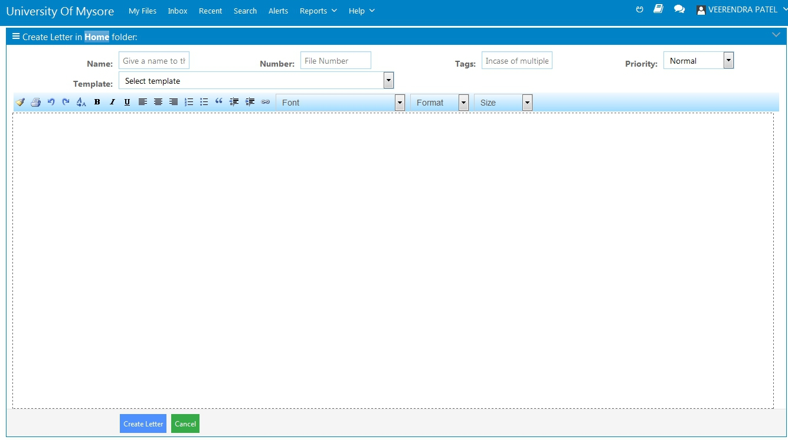
CREATE LETTER
The user can create a letter in a folder by specifying the name and number through this screen

Slide 9
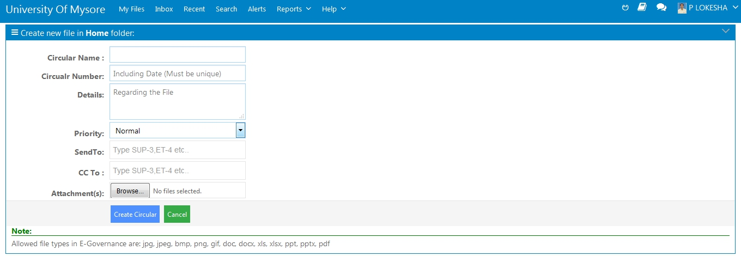
CREATE CIRCULAR
The user can create a circular by specifying the circular name, circular number and attachments through this screen

Slide 10
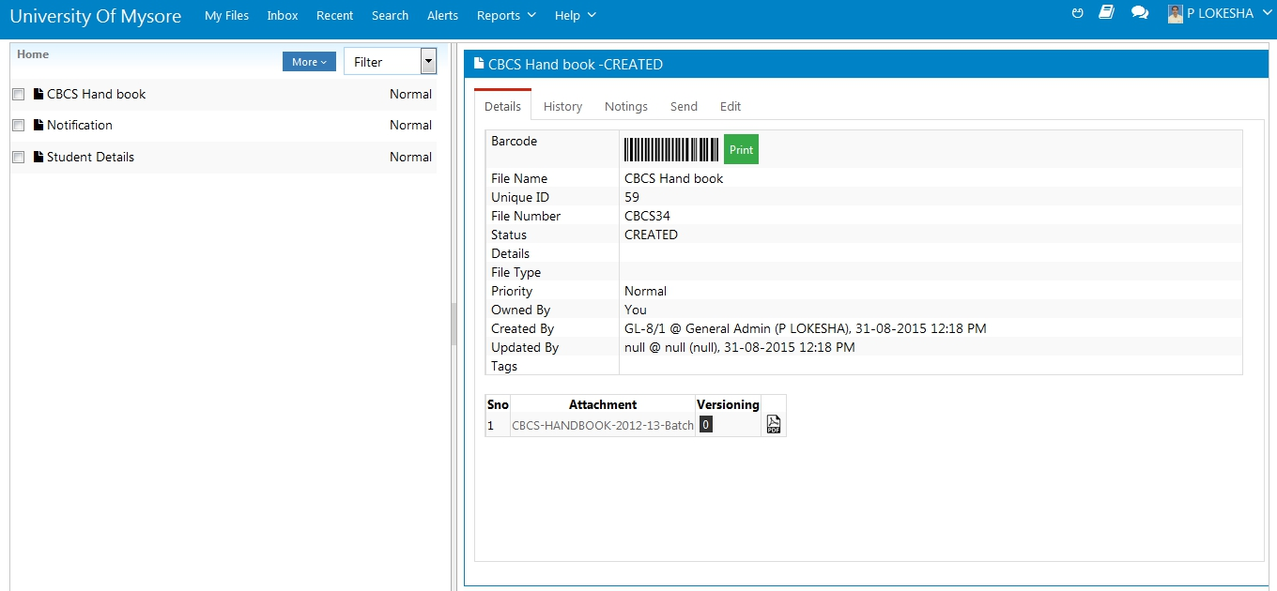
FILE DETAILS
The user can view the file details like file number, file status, created by and updated by in this screen

Slide 11
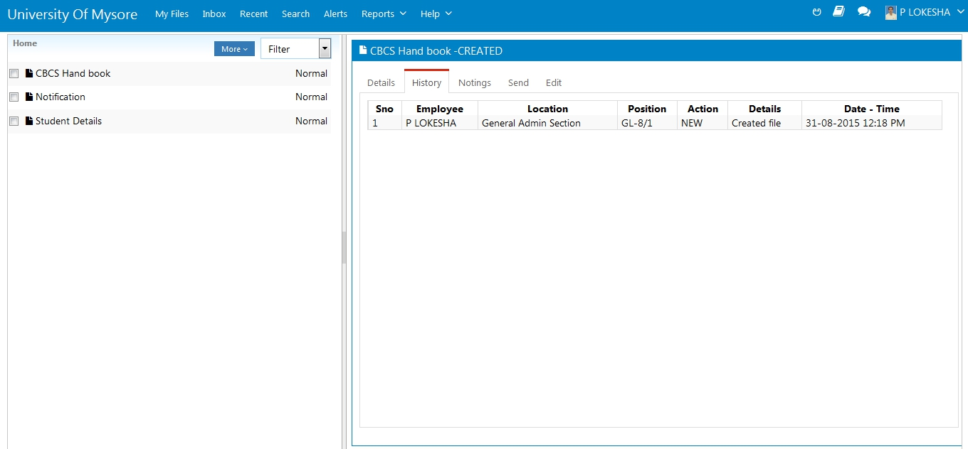
FILE HISTORY
The user can view the file history in this screen

Slide 12
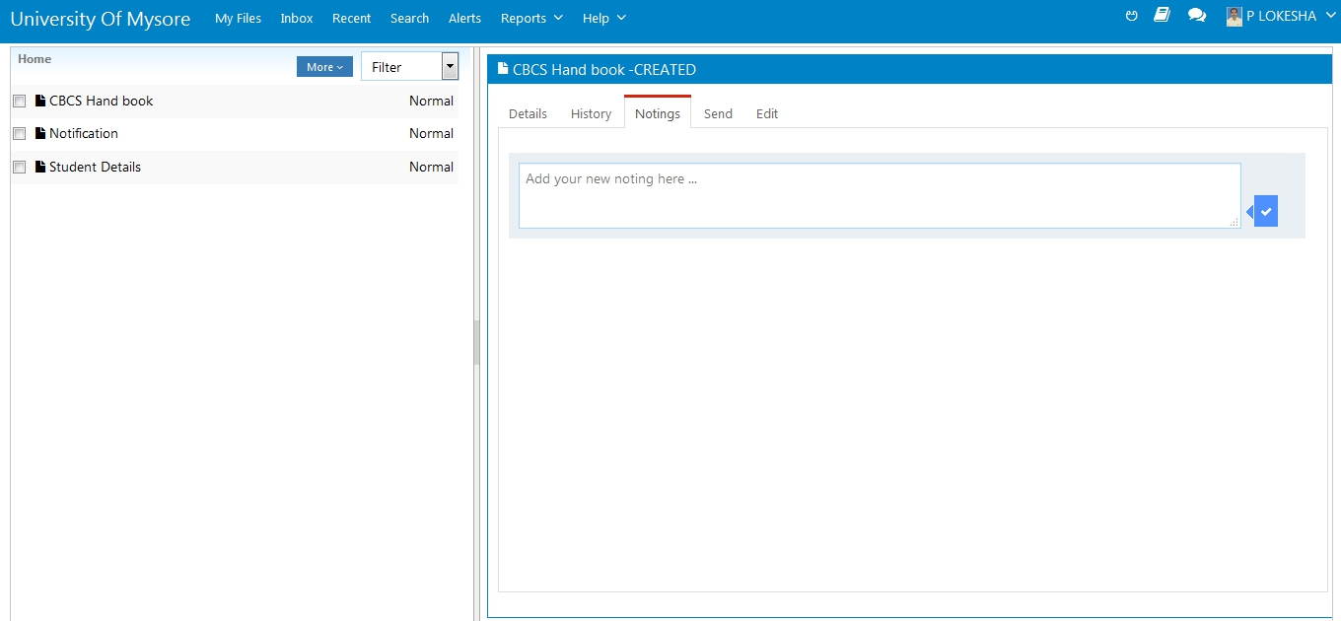
FILE NOTINGS
The permitted users can view and make the file notings in this screen

Slide 13
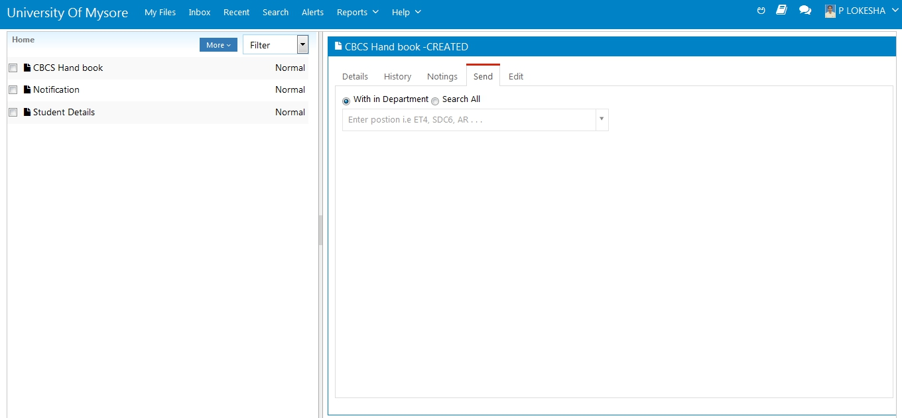
SEND A FILE
The user can send a file within the department or to any particular user by using search all through this screen

Slide 14
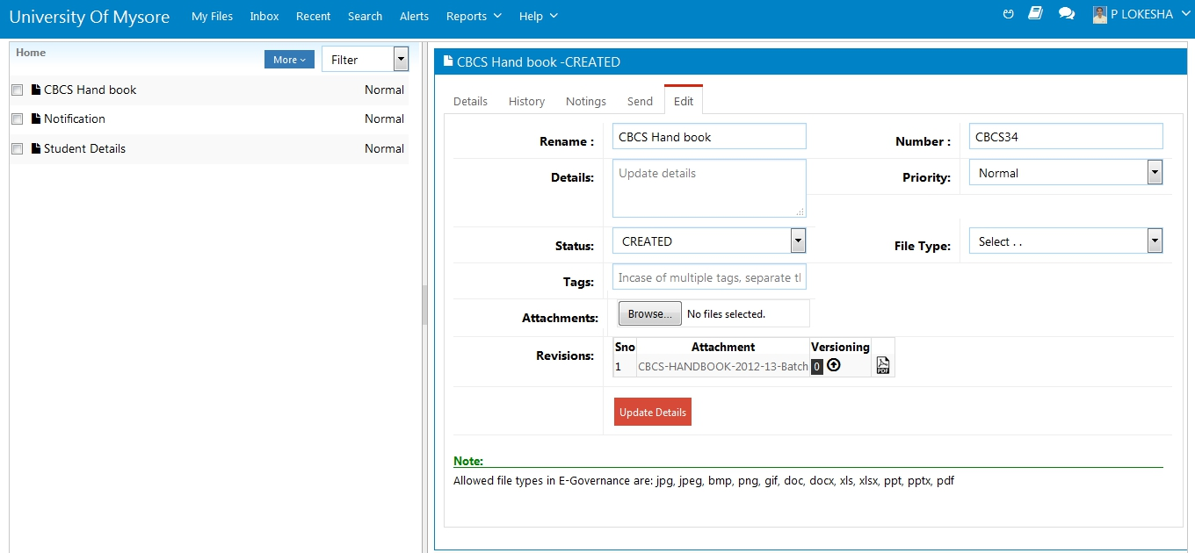
EDIT A FILE
The permitted users can edit a file through this screen

Slide 15
RECEIVE A FILE
The file sent by a particular user to the other user can be received by entering the File Number OR File ID through this screen

Slide 16
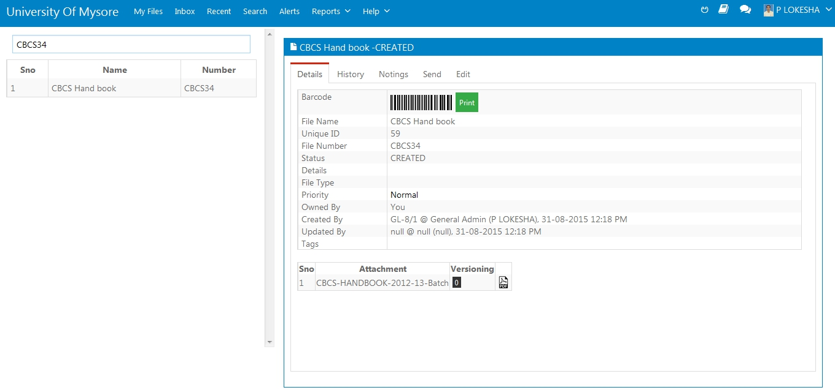
SEARCH A FILE
The user can search a file by entering the File Number through this screen

Slide 17
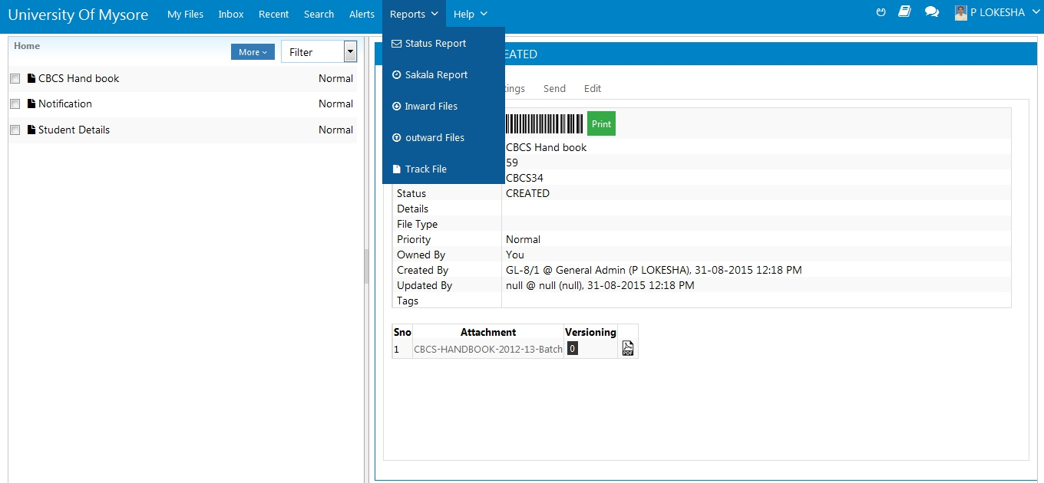
DMS REPORTS
The user can view all the DMS Reports like Status Report, Sakala Report, Inward Files & Outward Files in this screen

Slide 18
STATUTORY DOCS
All the Statutory Documents can be viewed by all the DMS users in this screen

Slide 19
ARCHIVE FILES
The files can be archived by the user by entering the file name, number and attachments through this screen

Slide 20
SEARCH ARCHIVE FILES
The user can search for the archived file by entering the file name OR number through this screen

Slide 21
DEPARTMENT WISE ARCHIVE STATUS
The user can view the department wise file archive status in this screen

Slide 22
UNIVERSITY OF MYSORE
HRMS CONFIGURATION

Slide 23
CREATE BRANCH
The user can create a Branch/Department/Section by selecting the governing body type through this screen

Slide 24
POSITION TYPES
The user can create a Position Type through this screen

Slide 25
JOB TYPES
The user can create a Job Type through this screen

Slide 26
EMPLOYEE TYPES
The user can create Employee Type through this screen

Slide 27
RECRUITMENT TYPE
The user can create Recruitment Type through this screen

Slide 28
QUALIFICATIONS
The user can create Qualifications through this screen

Slide 29
DESIGNATIONS
The user can create a Designation through this screen

Slide 30
CREATE POSITION
The user can create a Position (Chair) by selecting the Position Type through this screen

Slide 31
LEAVE TYPES
The user can create Leave Type through this screen

Slide 32
PAY COMMISSION
The user can create a Pay Commission Type through this screen

Slide 33
PAY TYPES
The user can create a Pay Type through this screen

Slide 34
UNIVERSITY OF MYSORE
EMPLOYEES MODULE

Slide 35
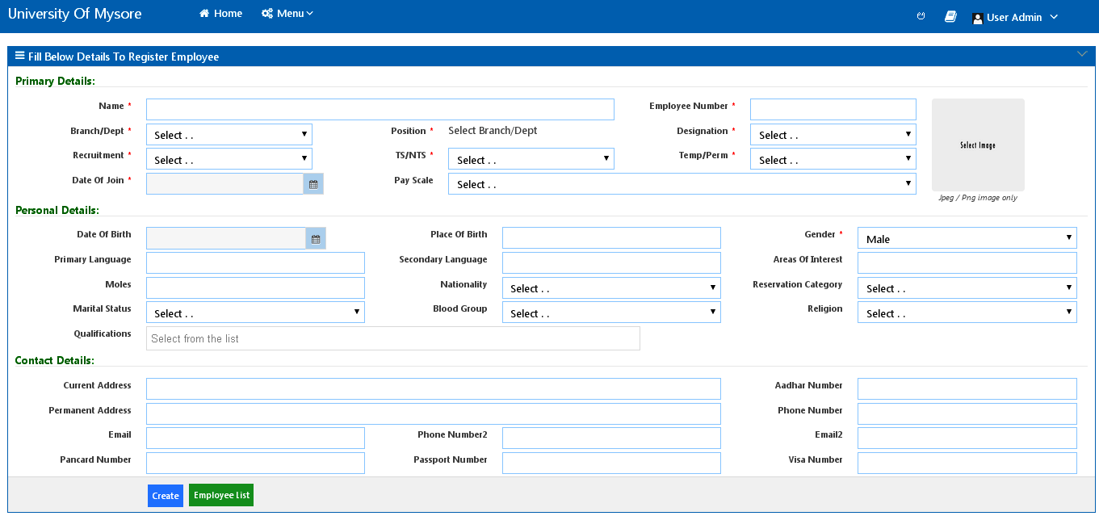
CREATE EMPLOYEE
The admin user can create an Employee by filling all the required employee details through this screen

Slide 36
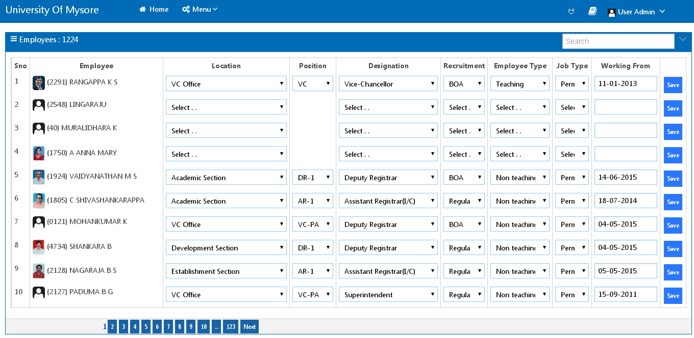
ASSIGN DESIGNATION
The admin user can assign designation to an employee by selecting the designation, position, etc.. through this screen

Slide 37
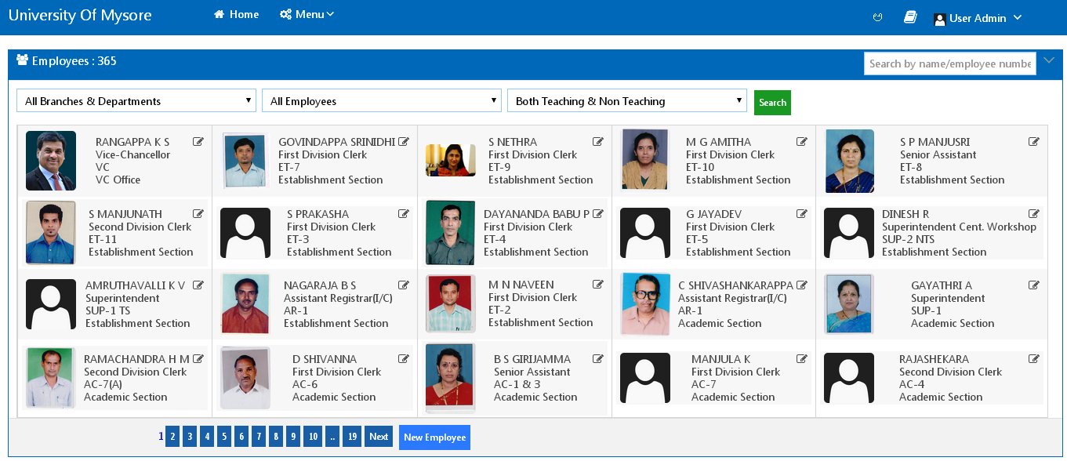
EMPLOYEES LIST
The user can view the Employees List in this screen

Slide 38
SERVICE REGISTER
The user can view the Employee Service Register in this screen

Slide 39
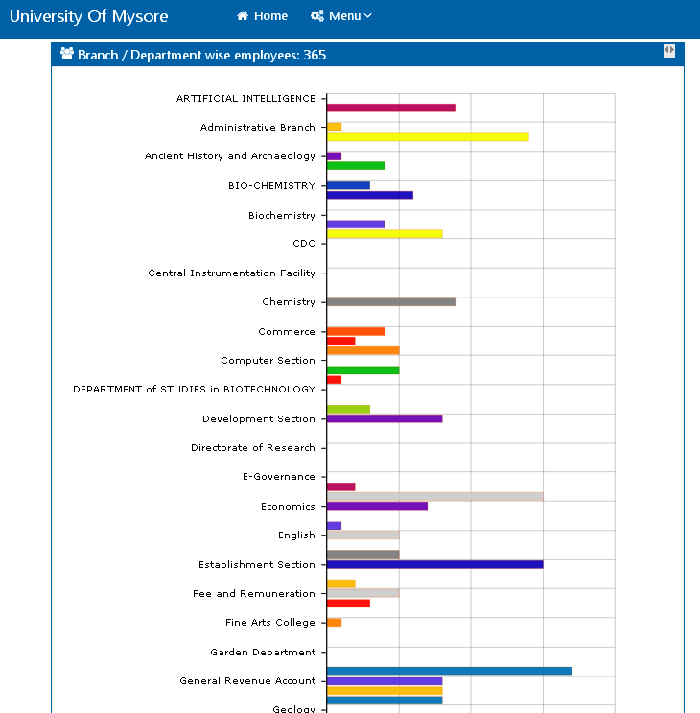
DEPARTMENT WISE
The user can view Department Wise Employees Report in this screen

Slide 40
GROUP WISE
The user can view Group Wise Employees Report (Gender Wise, Category Wise and Designation Wise) in this screen

Slide 41
UNIVERSITY OF MYSORE
PAYROLL MODULE

Slide 42
PAYSCALE
The admin user can create/edit Pay Scale for Employee by adding the Grade Pay through this screen

Slide 43
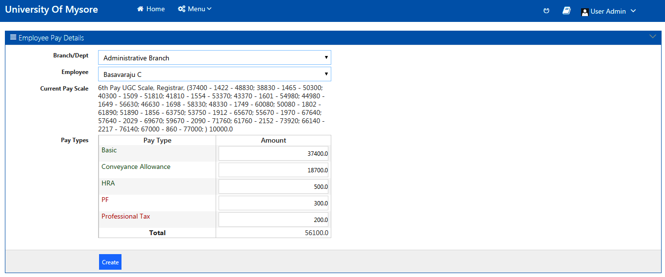
ASSIGN PAY TYPE
The admin user can assign Pay Type to the Employee by adding the Pay Type Values through this screen

Slide 44
POST SALARIES
The admin user can Post Salaries by selecting the Department, Month and Year through this screen

Slide 45
PAYSLIP
The admin user can Generate Pay Slip for all Employees OR for a Single Employee for the Selected Month and Year through this screen

Slide 46
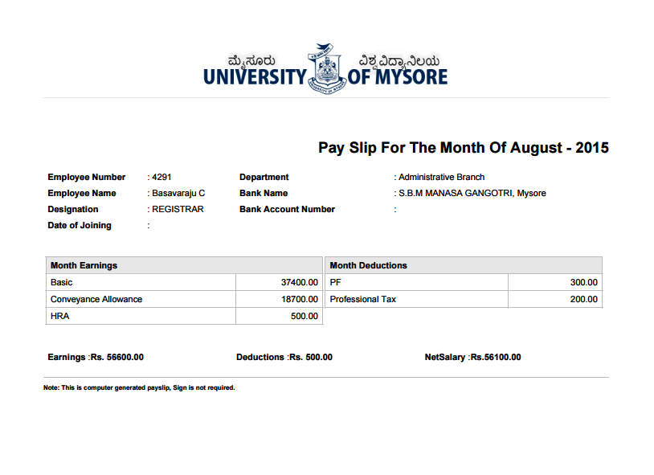
VIEW PAYSLIP
The users can view their Pay Slips in their respective Dashboards (View a Sample Below)

Slide 47
UNIVERSITY OF MYSORE
ATTENDANCE MODULE

Slide 48
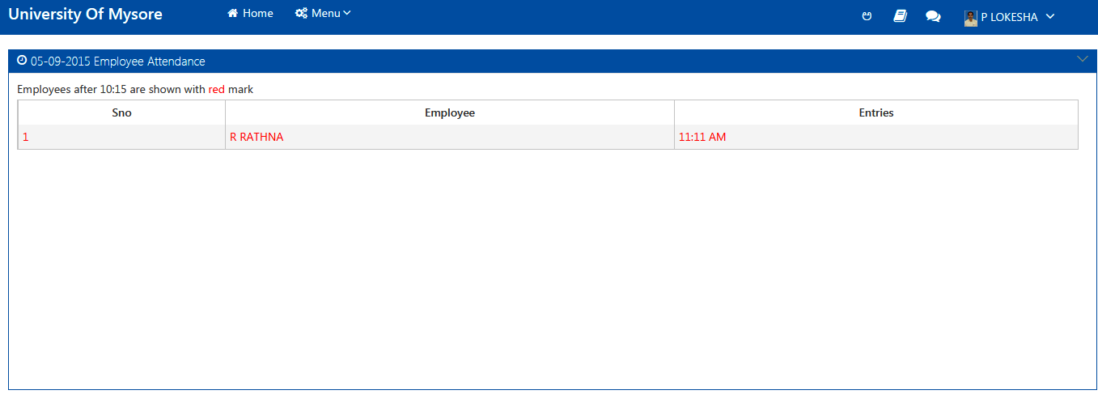
ATTENDANCE REPORT
The user can view the Employee Attendance Day Report through this screen

Slide 49
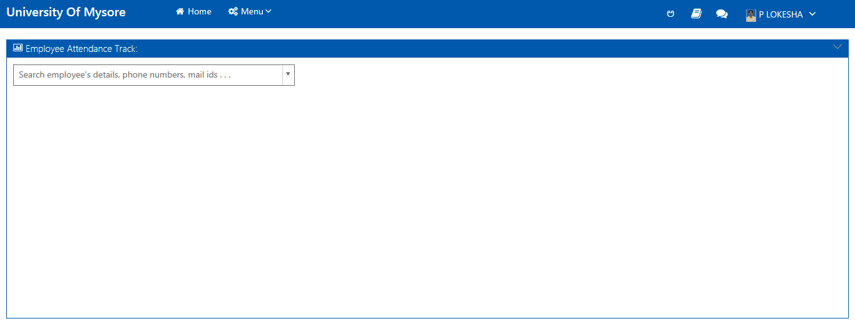
TRACK ATTENDANCE
The user can track a Particular Employee Attendance by entering the employee details like Phone Number OR Mail ID in the search bar through this screen

Slide 50
UNIVERSITY OF MYSORE
LEAVES MODULE

Slide 51
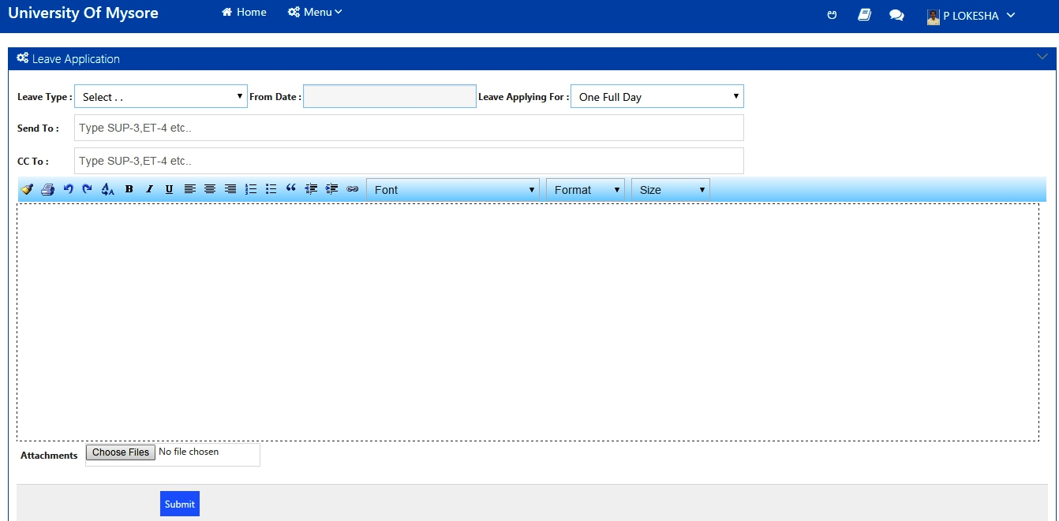
APPLY LEAVE
The user can apply for leave from his dashboard by selecting the leave type and dates through this screen

Slide 52
APPLIED LEAVES
The user can view the applied leaves list in his dashboard through this screen

Slide 53
OLD LEAVES
The user can view the old leaves list in his dashboard by entering the employee number through this screen

Slide 54
UNIVERSITY OF MYSORE
Finance MODULE

Slide 55
NEW FINANCE GROUP
The user can create a New Finance Group through this screen

Slide 56
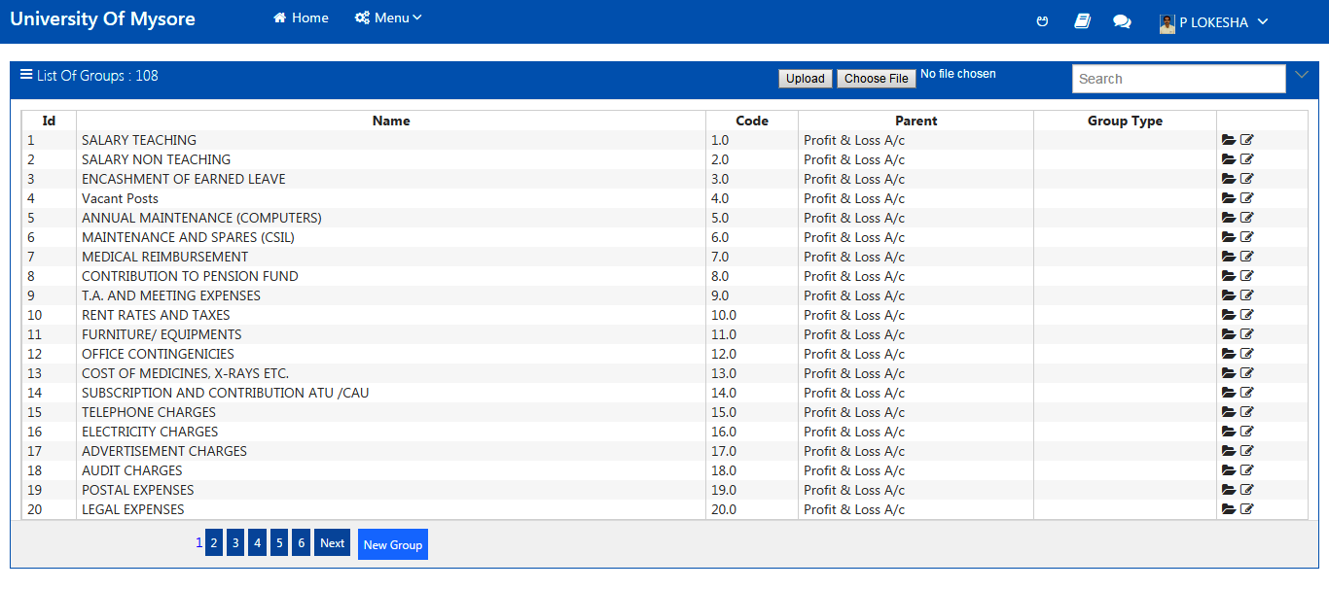
FINANCE GROUPS
The user can view/edit the created Finance Groups List through this screen

Slide 57
NEW FINANCE ACCOUNT
The user can create a New Finance Account by selecting the required Finance Group through this screen

Slide 58
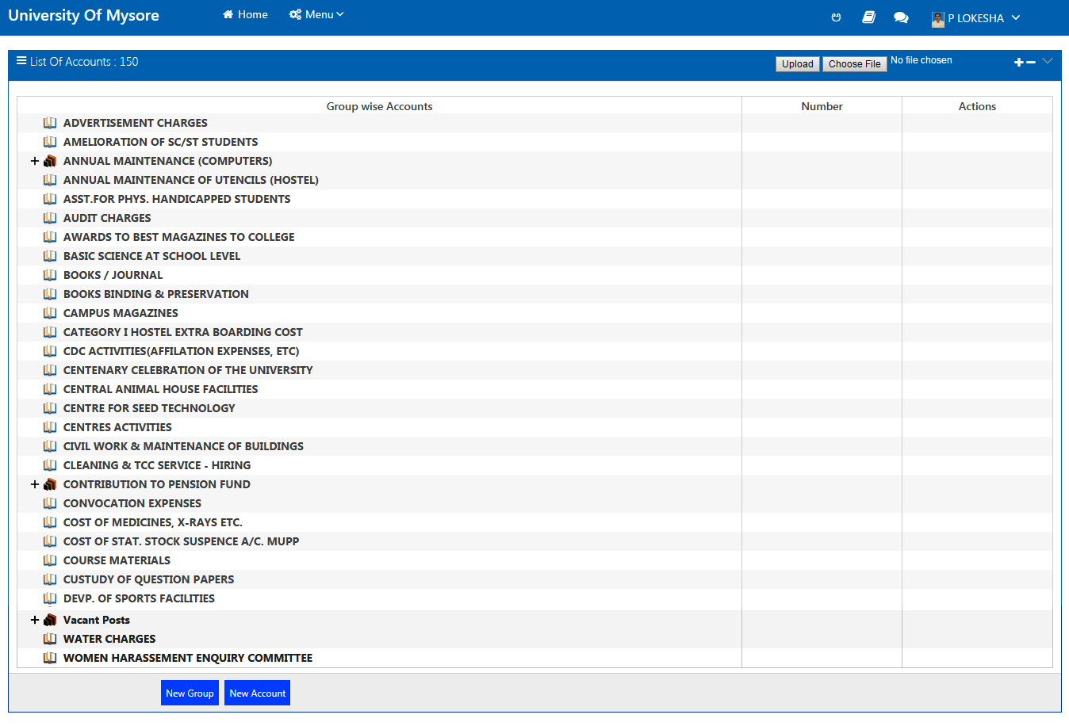
CHART OF ACCOUNT
The user can view created Finance Accounts in this screen

Slide 59
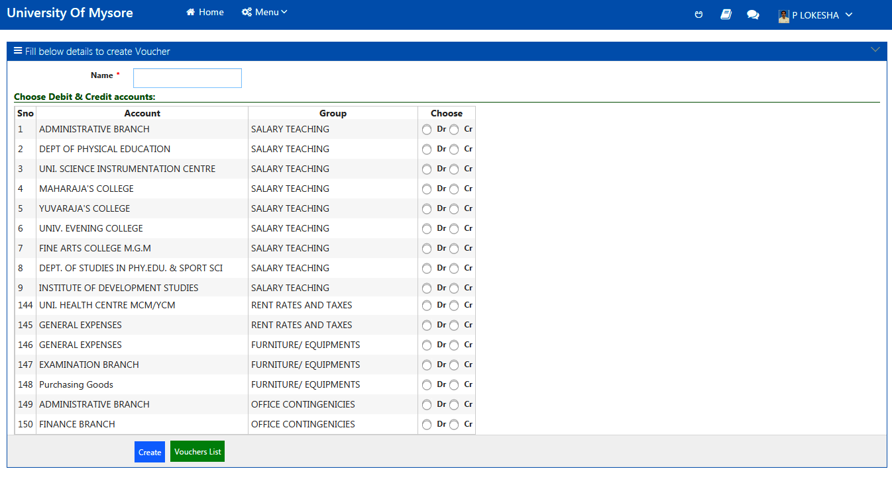
CREATE VOUCHER
The user can create a Voucher by choosing either Debit or Credit for voucher required Accounts through this screen

Slide 60
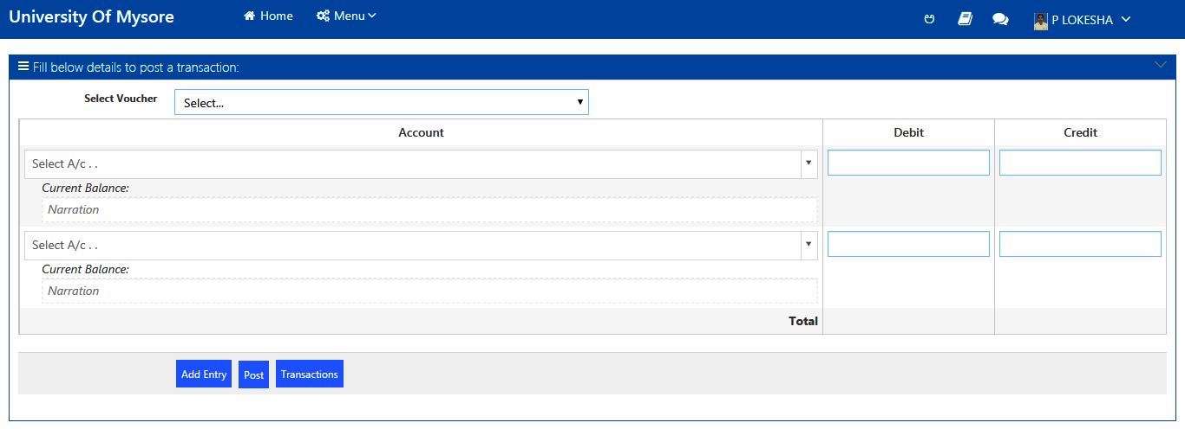
POST TRANSACTION
The user can Post Transactions by selecting a Voucher and entering the Debit or Credit values for the accounts that require posting transactions through this screen

Slide 61
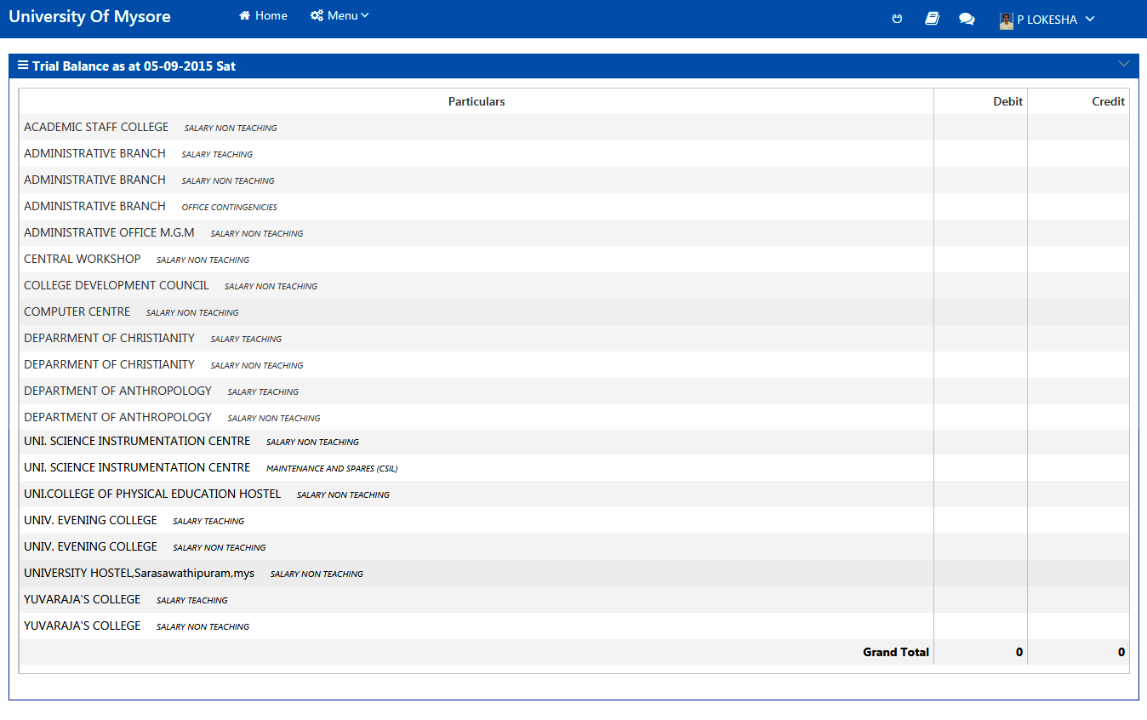
TRIAL BALANCE
The Trial Balance with debit and credit values can be viewed in this screen

Slide 62
UNIVERSITY OF MYSORE
Projects MODULE

Slide 63
NEW PROJECT
The user can Create a New Project by entering the Primary required project details through this screen

Slide 64
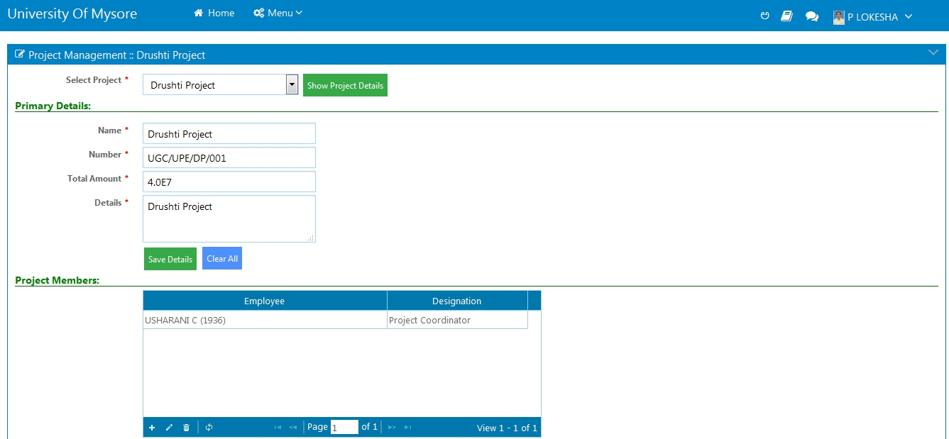
PROJECT DETAILS
The user can view the created Project details by selecting the project through this screen

Slide 65
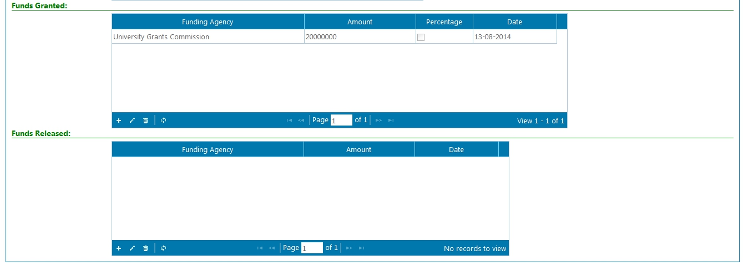
PROJECT DETAILS
Project Details Screen Continuation

Slide 66
UNIVERSITY OF MYSORE
E-procurement MODULE

Slide 67
NEW TENDER
The user can Create a New Tender by entering the required Tender details through this screen

Slide 68
UPDATE TENDER
The user can Update a Tender by entering the Tender Name or Number in the Search bar through this screen

Slide 69
SEARCH TENDER
The user can Search a Tender by entering the Tender Name or Number in the Search bar through this screen

Slide 70
DATEWISE SEARCH
The user can Search a Tender Date Wise by entering the required Dates through this screen

Slide 71
UNIVERSITY OF MYSORE
Ioe MODULE

Slide 72
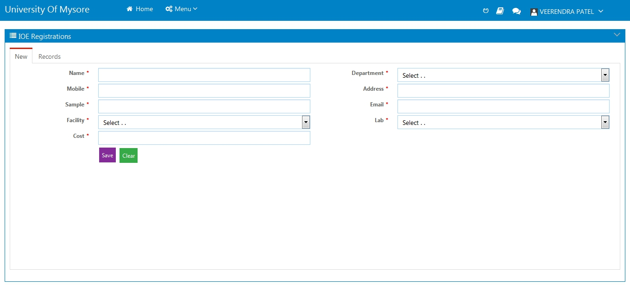
NEW REGISTRATIONS
An IOE user can Create a New IOE Registration by entering the required IOE Registration details through this screen

Slide 73
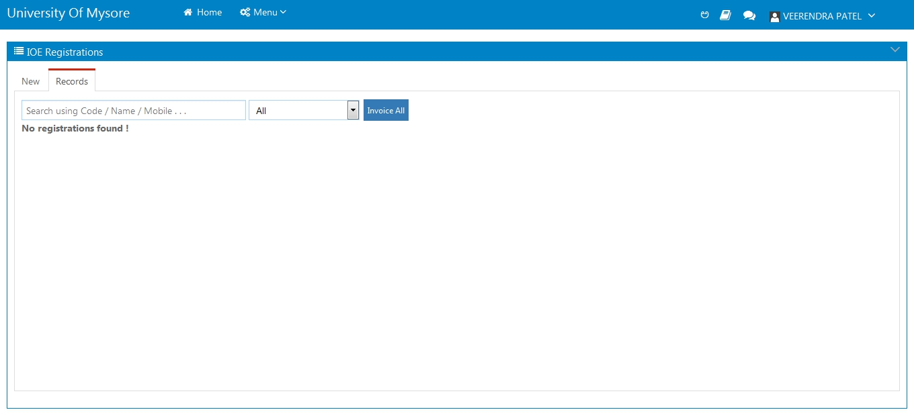
RECORDS
An IOE user can Search for the IOE Records by entering the IOE Registration code OR Name through this screen

Slide 74
UNIVERSITY OF MYSORE
Icd MODULE

Slide 75
NEW CONECTION
User can apply for a New Internet Connection Request by entering the required details through this screen

Slide 76
CONECTIONS LIST
List of Internet Connection Requests can be viewed/searched by the user through this screen

Slide 77
UNIVERSITY OF MYSORE
THANK YOU

